Slide 1
Chongqing University of Technology
ATAI
Advanced Technique of Artificial Intelligence
Chongqing University of Technology
BASS：Boosting Abstractive Summarization with Unified Semantic Graph
Wenhao Wu1∗, Wei Li2, Xinyan Xiao2, Jiachen Liu2,Ziqiang Cao3, Sujian Li1†, Hua Wu2,
Haifeng Wang2
1Key Laboratory of Computational Linguistics, MOE, Peking University
2Baidu Inc., Beijing, China
3Institute of Artificial Intelligence, Soochow University, China
{waynewu,lisujian}@pku.edu.cn
{liwei85,xiaoxinyan,liujiachen,wu hua,wanghaifeng}@baidu.com
{zqcao}@suda.edu.cn
—— ACL2021
2021.9.14 • ChongQing
Reported by Sijin Liu

Slide 2
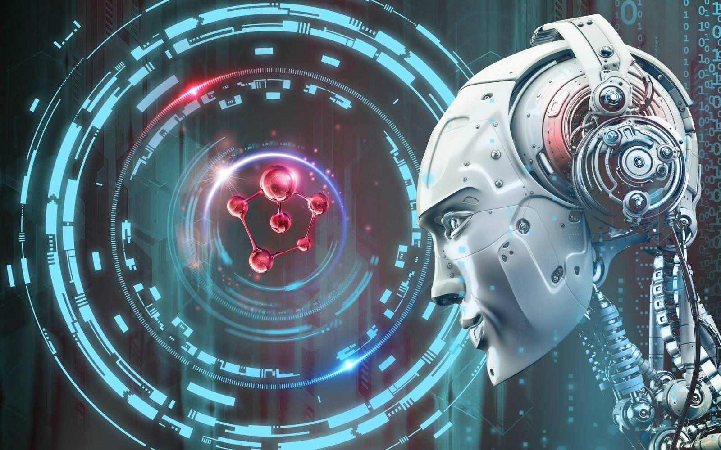
Chongqing University of Technology
ATAI
Advanced Technique of Artificial Intelligence
Chongqing University of Technology
1.Introduction
2.Method
3.Experiments

Slide 3
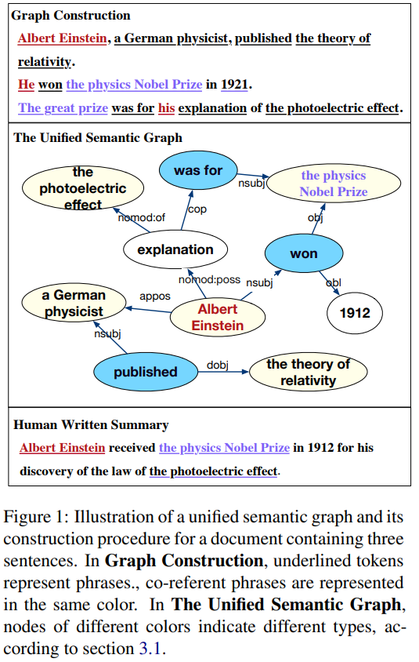
Introduction
Complex summarization scenarios such as long-document or multi-document summarization (MDS), still bring great challenges to Seq2Seq models.
The sentence-relation graph is not flexible for fine-grained (such as entities) information aggregation and relation modeling.
We further propose a graph-based encoder-decoder model based on the unified semantic graph.
Notes:
在对话系统中，对话行为识别和情感分类是两个相关任务，能够帮助进行识别说话者的意图。其中，对话行为能够展示说话者显式的意图，而情感能展现说话者隐式的意图 [1]。
更具体的来说，对话行为识别和对话情感分类都可以看作是分类任务，目标是将对话中的每条语句标注上对应的DA标签和SC标签。
直观上，有两个关键因素有助于对话行为识别和情感预测。一个是跨任务的相互交互信息mutual interaction information，另一个是对话中的上下文信息context information。
如图3所示，前人的联合建模工作中，Cerisara等人[1]专注于相互交互信息（图3左），Kim等人[2]专注于对话历史信息（图3右）。最近，Qin等人[3]提出DCR-Net模型，虽然取得了较好效果，但是该模型却是以一种pipeline的方式来获取两种信息：在Encoder端获取对话历史信息，在relation layer端获取交互信息。但是我们认为，该类流水线式的模型存在一个问题： 两种信息是单独建模的。
所以接下来的问题是： 我们是否可以在一个统一的框架中同时对相互交互信息和上下文信息建模，来将它们完全整合呢？

Slide 4
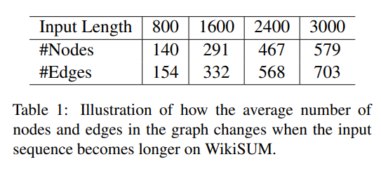
Method
Unified Semantic Graph
We employ CoreNLP to obtain coreference chains of the input sequence and the dependency parsing tree of each sentence.
Every node in $V$ represents a concept merged from co-referent phrases.
Noun phrase (N), Verb phrase(V), Other phrase (O).
Every edge $e_{ij}∈ E$in our graph belongs to a type of dependency parsing relation.
Notes:
如图所示，这是模型的整体框架。由三部分组成，第一部分为分层对话者感知编码器；第二部分为核心模块——协同图交互层；第三部分为解码器部分。将在以下部分中作详细介绍。

Slide 5
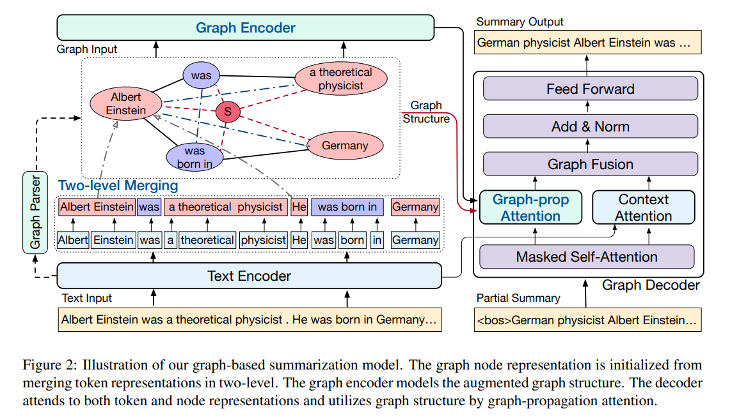
Method
Notes:
如图所示，这是模型的整体框架。由三部分组成，第一部分为分层对话者感知编码器；第二部分为核心模块——协同图交互层；第三部分为解码器部分。将在以下部分中作详细介绍。

Slide 6
Method
Graph Encoder
Node Initialization
Graph Augmentation
1. Add reverse edges and self-loop edges in graph
2. Supernode
3. Shortcut Edges: add shortcut edges between every node and its two-hop relation neighbors
Graph Encoding Layer
we apply Transformer layers for graph modeling by applying the graph adjacent matrix as self-attention mask

Slide 7
Method
Graph Decoder
Graph-propagate Attention
Let $β_{t}^{0}=α_{t}$ denotes the initial salient score predicted in previous step.
Where $\hat{A}= AD^{−1}$is a degree-normalized adjacent
matrix of the graph, and $ω ∈ (0,1]$is the teleport probability.

Slide 8
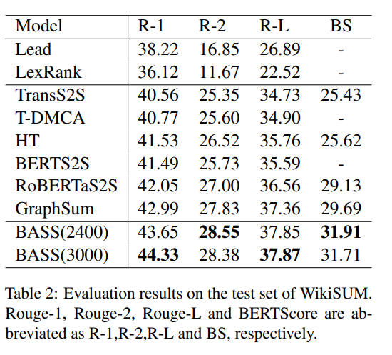
Experiments

Slide 9
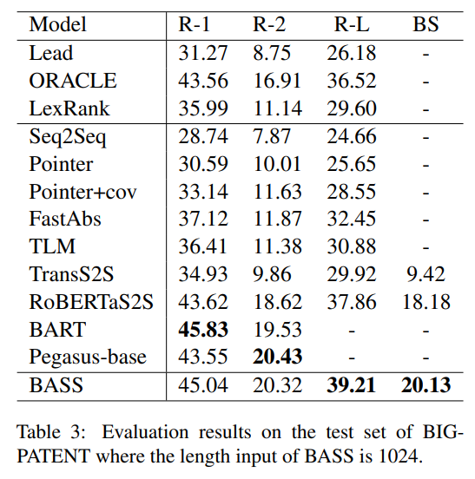
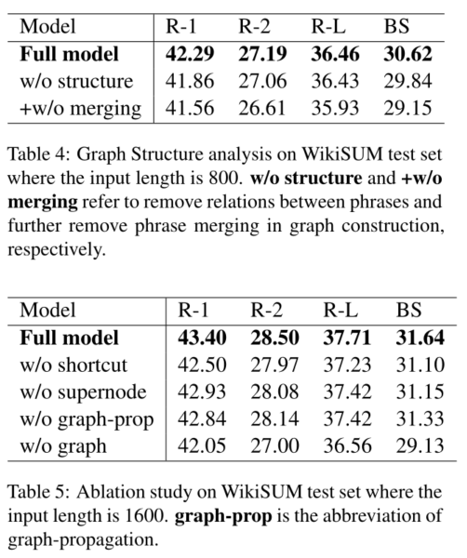
Experiments

Slide 10
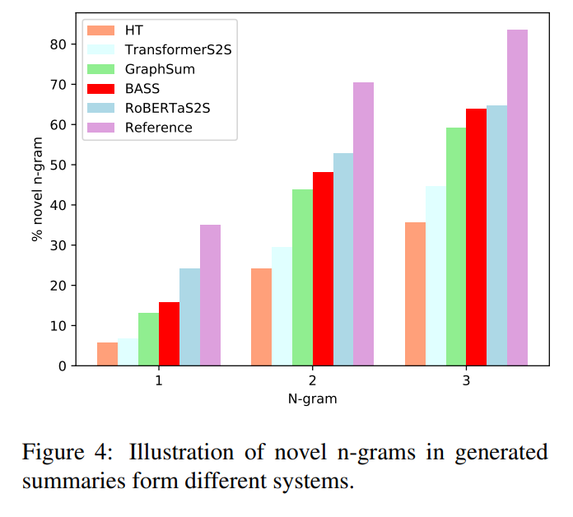
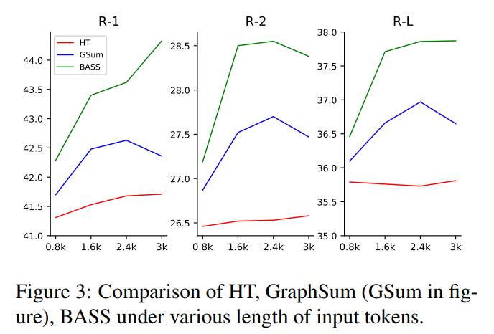
Experiments

Slide 11
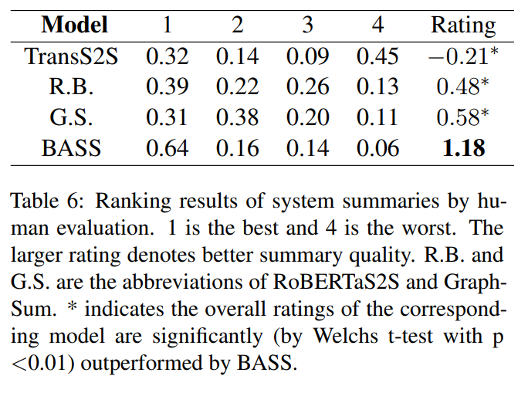
Experiments

Slide 12
Thank you!

